Slide 1


Globalization
Shift Happens

Slide 2
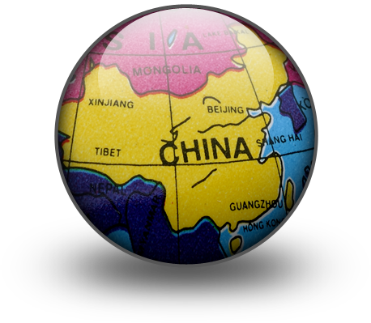

If you look at the tag on your shirt,
chances are you would see that it:
was made in a country other than the U.S.
and that before it reached your closet,
it could have very well been made
with Chinese cotton,
sewed by Thai hands
shipped across the Pacific on a French freighter to a
port in Los Angeles… crewed by Spaniards
Vietnam
INTERNATIONAL EXCHANGE –
…just one example of “Globalization”
Spain

Slide 3
Globalization:
Has many definitions, but generally it
refers to various global interconnections:
      Economic
      Political
      Social
McDonalds in Japan
The United Nations
music!

Slide 4
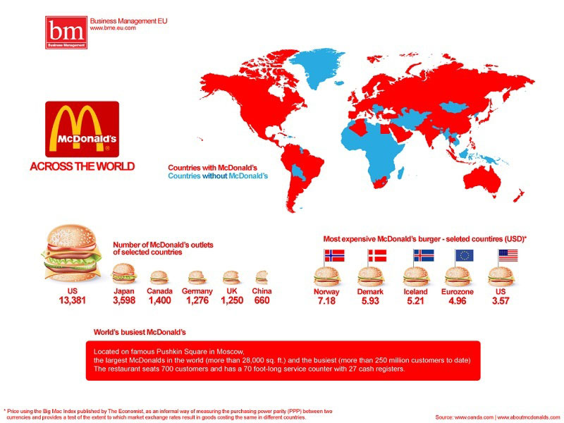

Slide 5
The idea of “Globalization” ….can be
simplified by identifying a few
KEY TRAITS:
#1
Improved Technology in Transportation
& Technology
  How did we communicate years ago without a
  phone, instant message, fax, or video conference?
  Today, anyone with $$ can easily book a plane
  flight and show up half way around the world
  in a matter of hours
The world begins to shrink….metaphorically

Slide 6
#2
Movement of People and Capital
  Today, people can move any where in the world
  in search of a new home, new job, or to
  flee a place of danger
      Immigration
  What has made capital ($$) move between
  countries faster than in the past?
Developing countries are a popular place for investors
to place their capital because of the enormous room for growth!
Electronic transfers

Slide 7
#3
Diffusion of Knowledge
  ‘Diffusion’ simply means “to spread out”….and that
  is exactly what any new-found knowledge does!
  When a new invention or way of doing something
  pops up, it doesn’t stay a secret for long.
How long did it take SE Asia to use the
tractors, and other farm machines…and
rely less on manual labor?

Slide 8
#3
Non-Governmental Organizations [NGOs]
& Multinational Corporations
  NGOs:
    many deal with issues that do not pay attention
    to borders/government:
        global warming
        energy use
        regulating child labor
    examples:
        Amnesty International
        Doctors without Borders

Slide 9
#3 (continued):
  Multinational Corporations
    The increased transportation & communication
    around the globe means MORE MARKETS TO
    SELL YOUR GOODS:
    Also…more businesses are going global because
    some jobs can be done by foreign workers
    for a much cheaper cost than domestic
    workers.
What is this called?
“Outsourcing”

Slide 10
RECAP

Slide 11
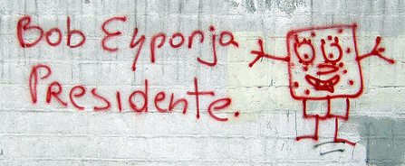

Globalization:
Refers to various global interconnections:
      Economic
      Social
      Political
GOOD or BAD?

Slide 12
Good or Bad?
  much heated debate
You decide!

Slide 13
Globalization:
Refers to various global interconnections:
      Economic
      Social
      Political
GOOD or BAD?
McDonalds in Japan
French films being shown in Philadelphia
The United Nations

Slide 14

Positive Aspects
As more $$ is poured in to developing countries,
there is a greater chance for the people in those
countries to economically succeed and increase
their standard of living.
Global competition encourages creativity and
innovation and keeps prices for goods/services in
check.
Developing countries are able to reap the benefits of
new technologies without having to go through
the “growing pains” associated with them… no need
to re-invent the wheel.

Slide 15
Positive Aspects
Governments are able to better work together toward
common goals now that there is an advantage in
cooperation, an improved ability to interact…a global
awareness of issues.
There is a greater access to foreign culture in the
form of movies, music, food, clothing…in short,
the world has more choices.

Slide 16
Negative Aspects
Outsourcing, while it provides jobs to a population
in one country, it takes away those jobs from another
country, leaving many without jobs.
As countries continue to interact, will cultures lose
their individuality?
There may be a greater chance of disease spreading
worldwide, as well as “bugs”…that could really harm
non-native ecosystems.
There is little international regulation…this could
cause dire consequences for the safety of people and
the environment.

Slide 17
Negative Aspects
Large Western-driven organizations such as the IMF
[International Monetary Fund] and the World Bank
make it easy for a developing country to obtain a
loan.
      However, what will the loan be granted for?
        will using the loan change their
        traditional culture?….
Ethnocentrism?

Slide 18


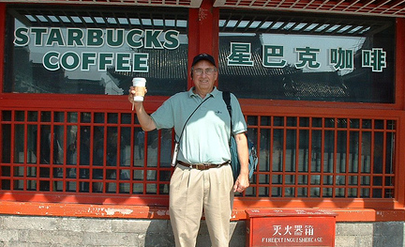
Corporate Expansion
Corporation ?
Multi-national
or trans-national corporations– businesses with
a headquarters
in one country but with business operations in a number of others.
No matter where you go in the world, certain businesses will always have a presence.
Copyright: mkeky, stock.xchng

Slide 19
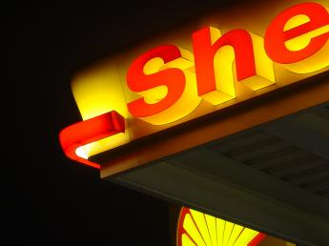
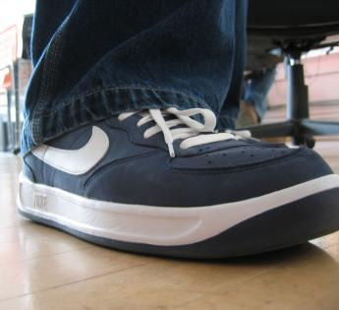
Corporate Domination
Key Issues
[problems]:
  Damage to the environment?
  Exploitation of labor?
  Monopoly power
  Economic degradation
  Non-renewable resources
  Damage to cultures
Shell and Nike’s activities have come under severe criticism
in some quarters.
Copyright: Homsel, stock.xchng

Slide 20
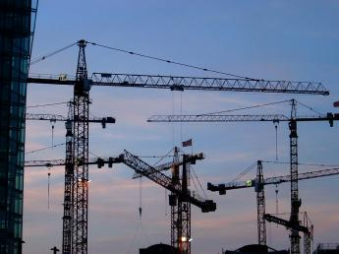
Trade versus Aid?
Benefits of Trade:
  Increased choice
  Greater potential for growth
  Greater employment opportunities
Trade has led to massive increases in wealth for many countries.
Copyright: budget stock, stock.xchng

Slide 21
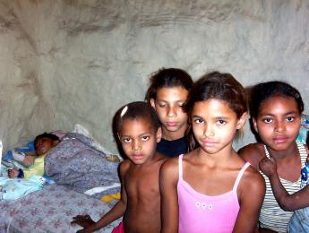
Trade versus Aid?
Disadvantages
of trade:
  Increase in gap between the rich and the poor
  Dominance of global trade by the rich, northern hemisphere countries
  Lack of opportunities for the poor to be able to have access to markets
  Exploitation of workers and growers
How far does trade help children like these?
Copyright: clesio, stock.xchng

Slide 22
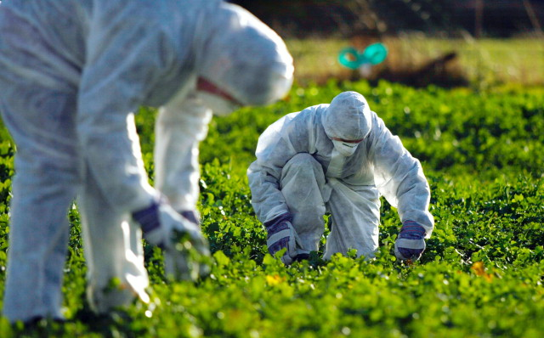
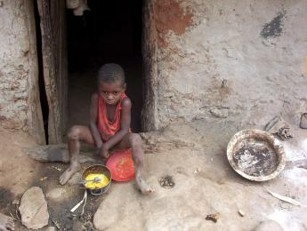

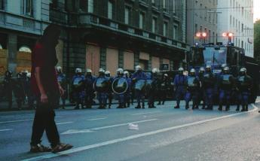
Other Issues:
Accountability
of Global businesses?
Ethical responsibility of business?
Efforts to remove trade barriers
Increased gap between rich and poor fuels
XENOPHOBIA
There are plenty of people who believe that globalization is a negative development, protests at the G8 summits, pollution, poverty and concern over GM crops are just some of the issues.
Copyright: stock.xchng

Slide 23
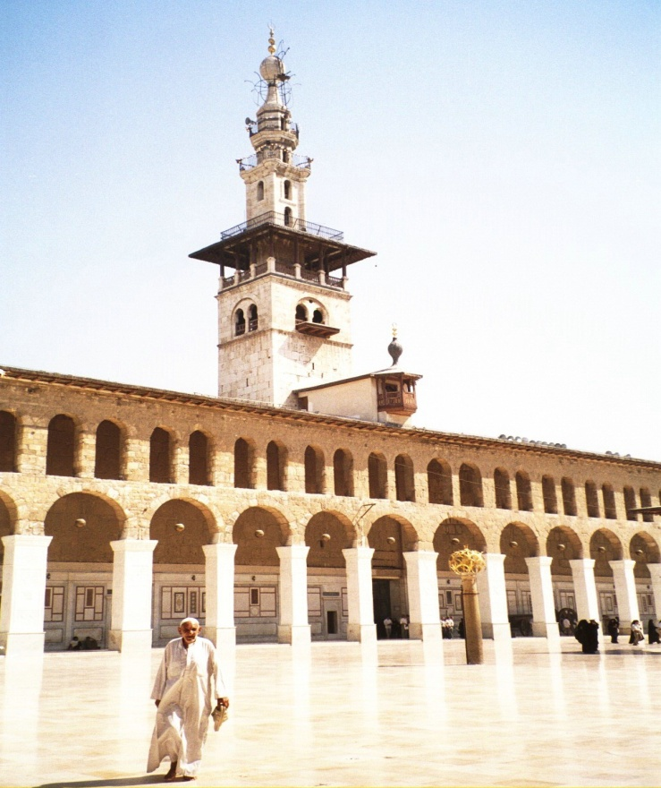
Western values and Islam?
TERRORISM????
ISSUE?

Slide 24
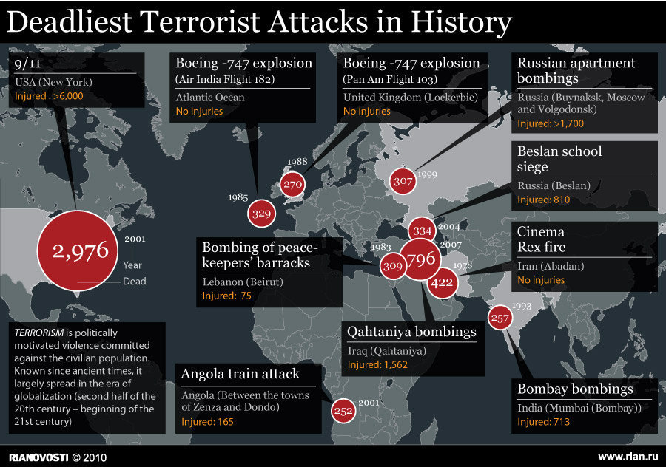

Slide 25
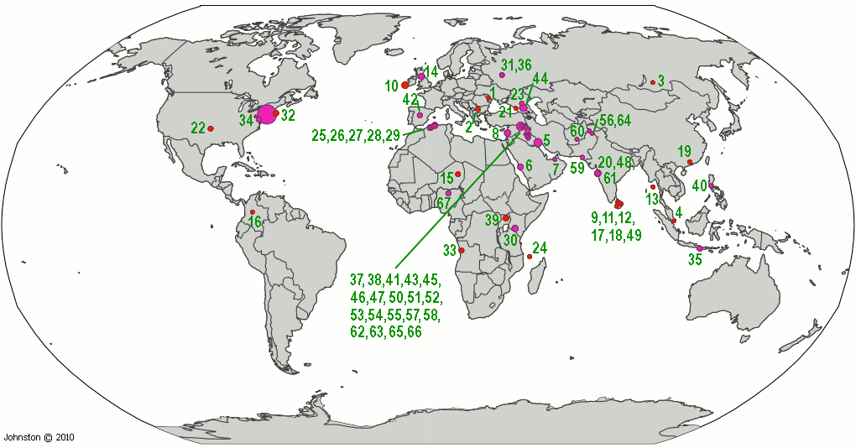
Map of worst terrorist attacks worldwide: 100 or more fatalities
(under construction)
compiled by Wm. Robert Johnston
List of attacks since 9-11
Map of worst terrorist attacks worldwide: 100 or more fatalities

Slide 26
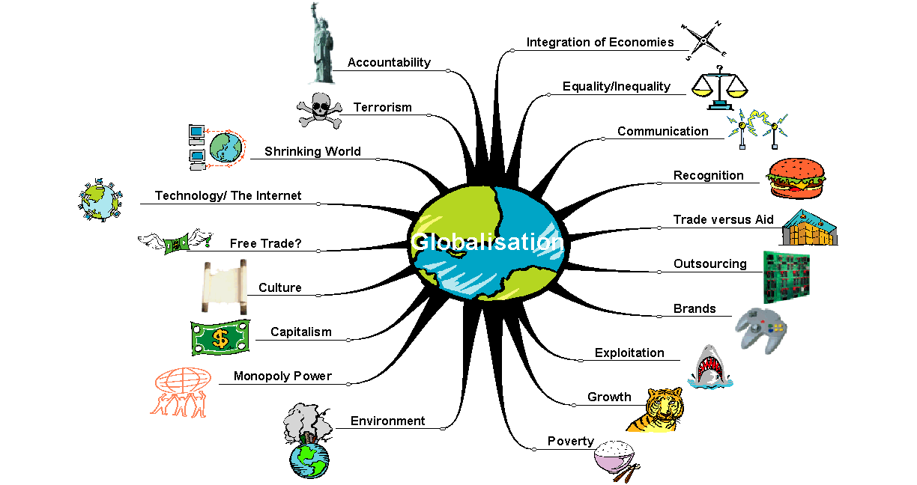
Globalisation
RECAP: Globalization could involve all these things!
Globalization

Slide 27
Good or Bad?
  much heated debate
You decide!

Slide 28
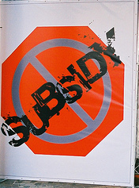

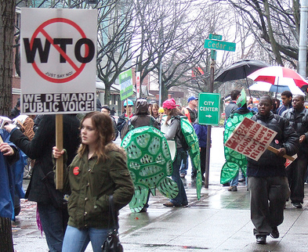
Contradictions in Globalization
GOOD or BAD?
Globalization has many inherent
contradictions including
It integrates and disintegrates
It fosters cooperation and conflict
It engenders order and disorder
It is divisive and unifying
So far, globalization has had both
positive and negative effects on global
peace

Slide 29
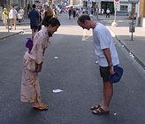
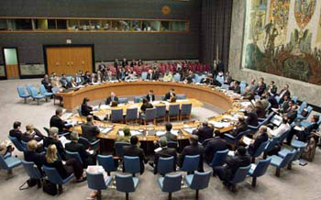
Globalization Is Here to Stay!
Globalization does have problems and
negative effects, but it is not going to
disappear. So…
We need to learn how to reap its
benefits, and minimize its costs. To do
that, we must:
Understand its impacts
Work to remedy the problems
Work to spread the benefits as widely as possible

Slide 30
Globalization Is Here to Stay!
Globalization does have problems and
negative effects, but it is not going to
disappear. So…
We need to learn how to reap its
benefits, and minimize its costs. To do
that, we must:
Understand its impacts
Work to remedy the problems
Work to spread the benefits as widely
as possible

Slide 31
What is a “world citizen?
Look at your previous answer.
…..on the reverse side of your index
card, if you would like to revise your
previous description, please do so NOW.
Sign your name to the side of your card
that you want me to read and post in class.
TURN IT IN!!!

Slide 32
“Find Someone Who….”
GLOBALIZATION
Positive Aspects
of
Globalization
Negative Aspects
of
Globalization
General Statement
All the statements handed out deal with “Globalization”.
Were would you put your “statement”?
  Positive example of Globalization?
  Negative?
  or is your statement just a “general statement”?
Review your notes and decide under which title you would place
your statement….and EXPLAIN WHY YOU WOULD DO SO.
When called on, “place it” and “explain” your reasoning.

Slide 33
Please sign on to your laptop!
Block 4
What’s up today?
Review PPT on Globalization and take quiz
Partners will create a concept map as an example of international [global] exchange.

